Slide 1

Hey Silly🤪
iPBL-Group2
Narabodee Namburee
Teetawat Bussabarati
Piyapach Singto
Naoki Kanda
Musashi Otsuka

Slide 2


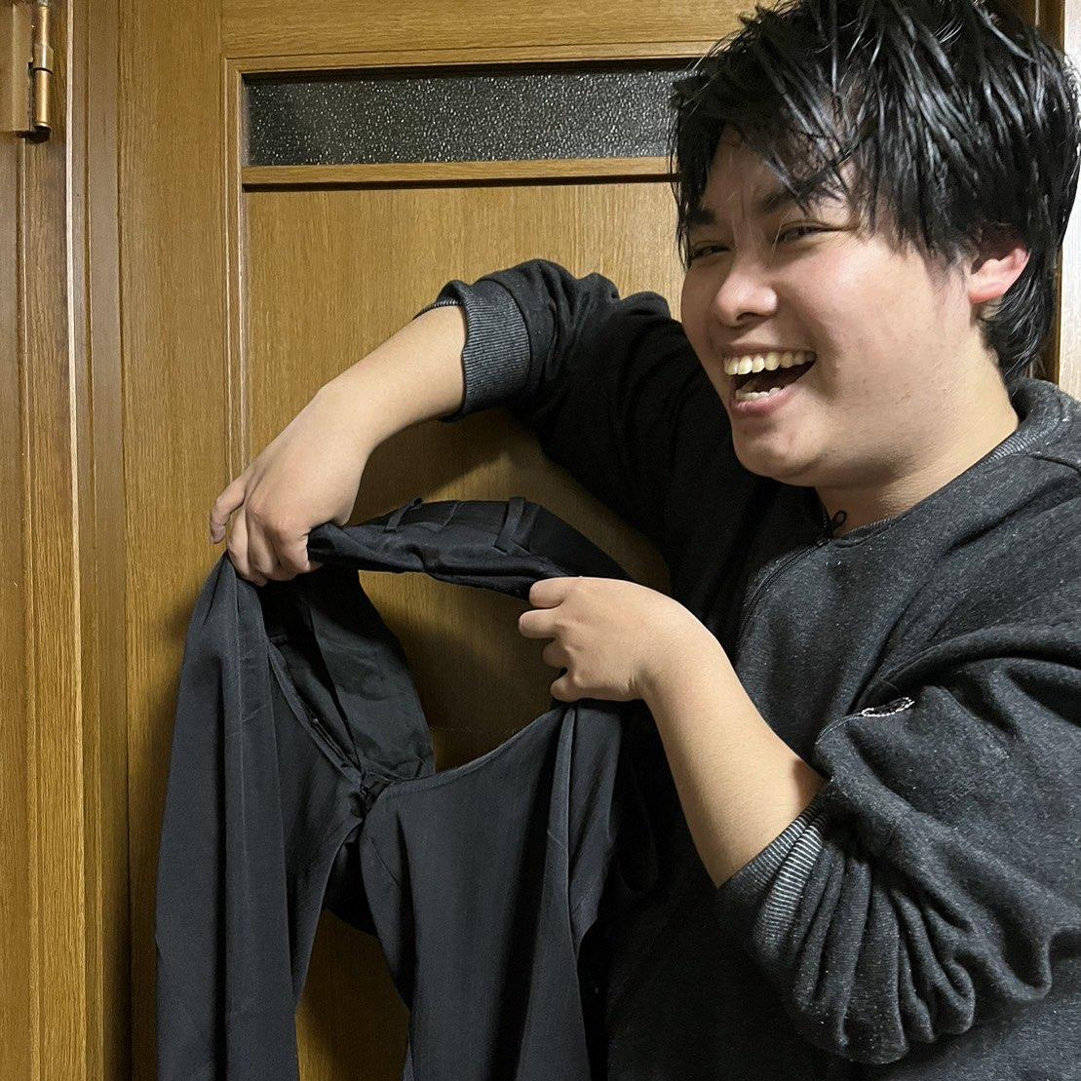
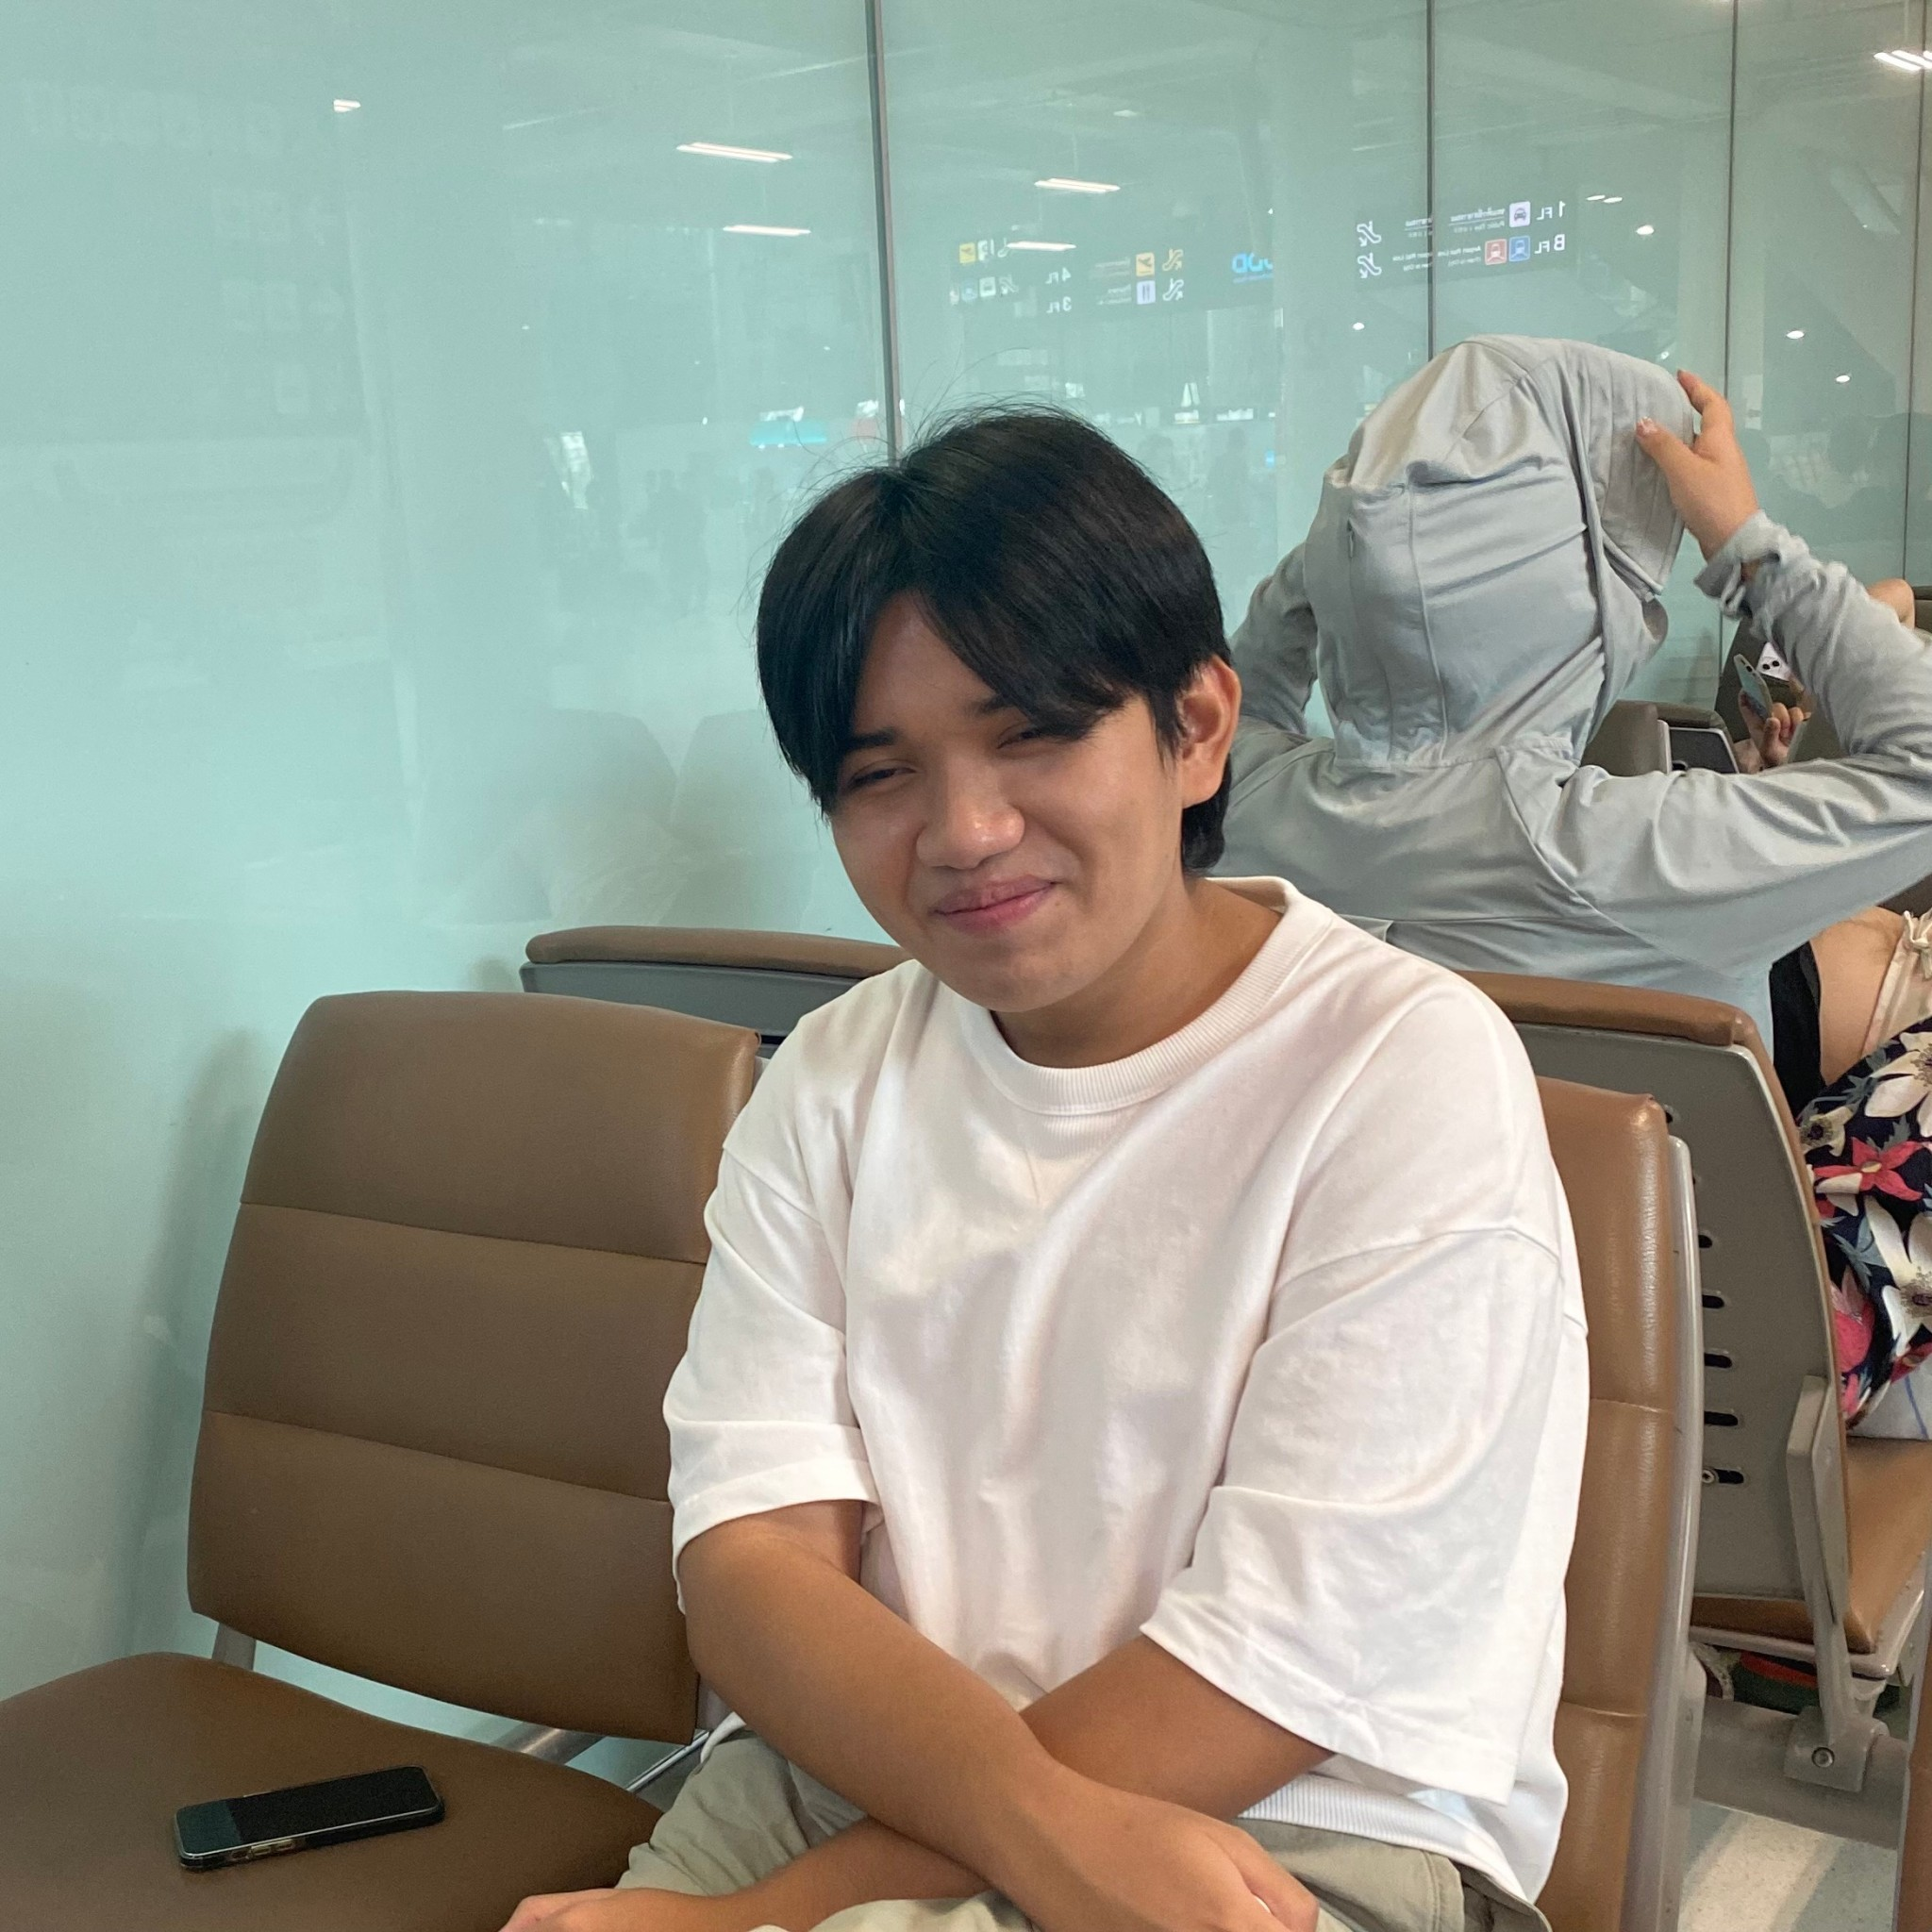
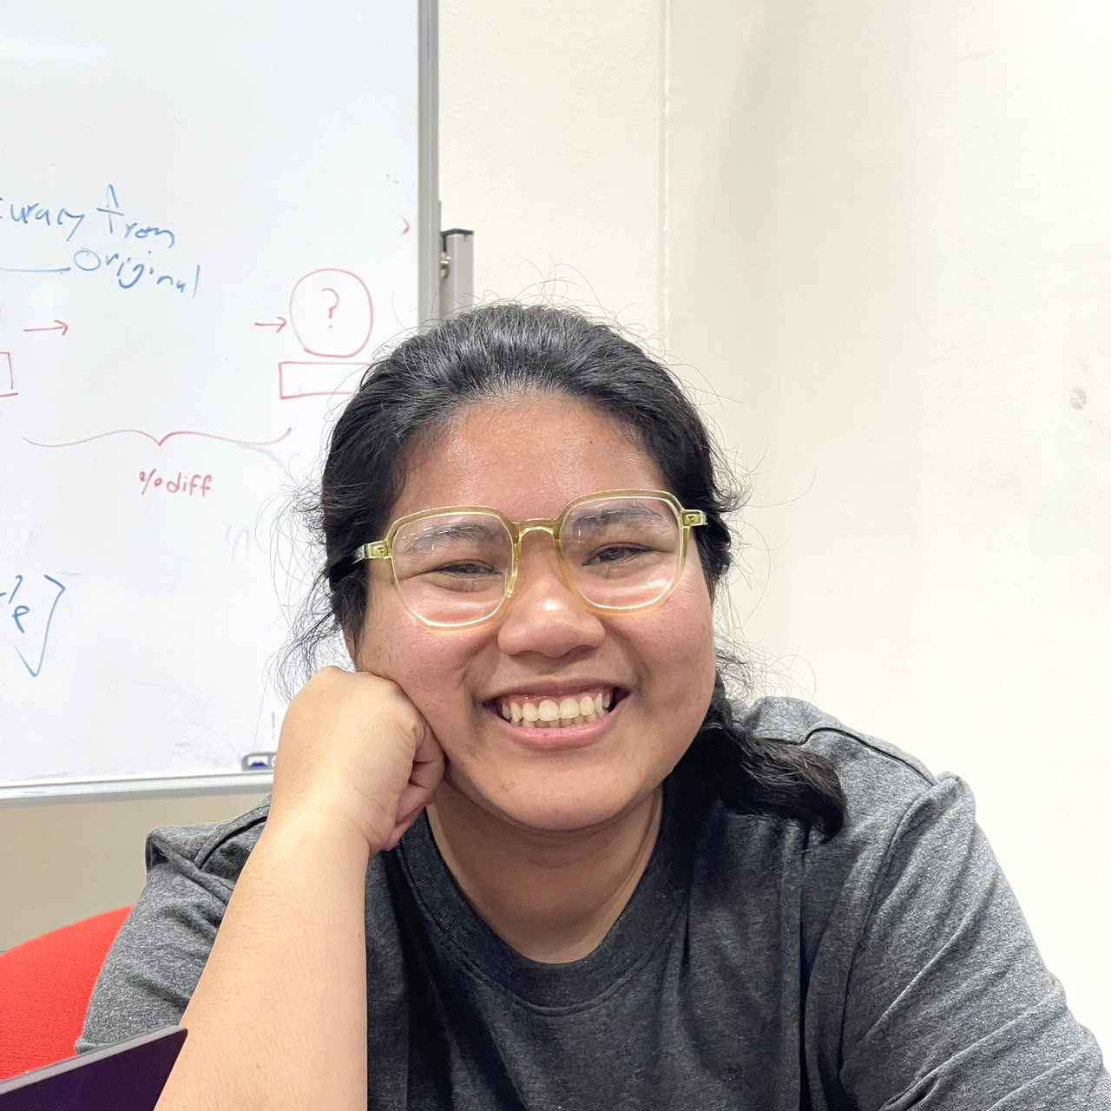
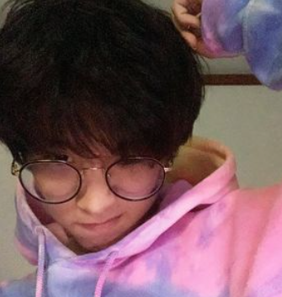
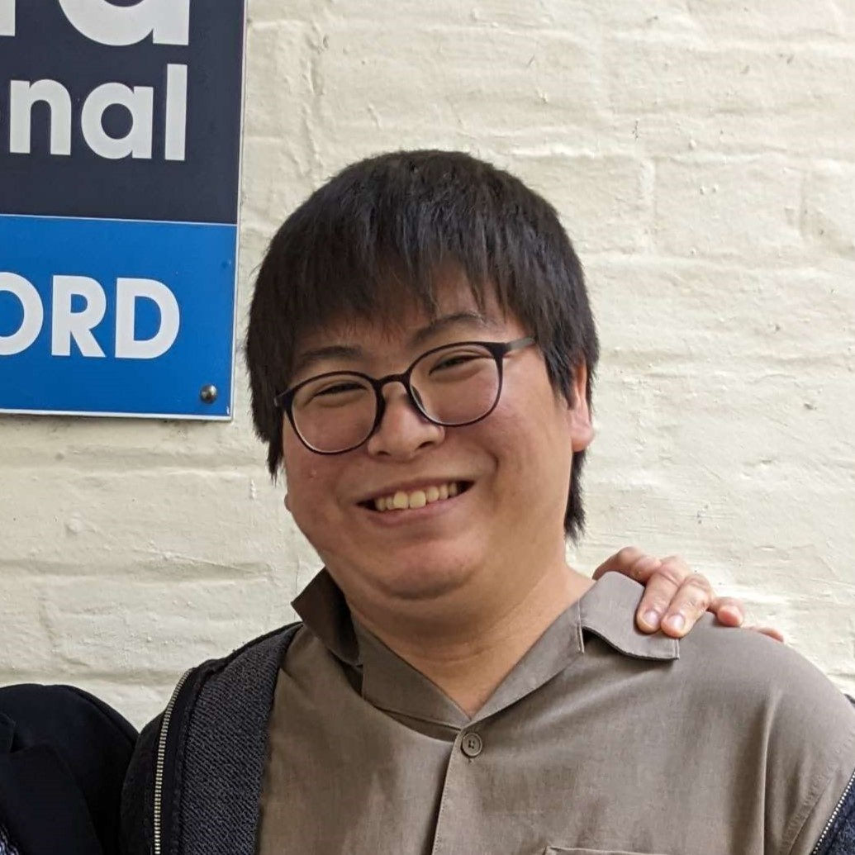



Hello!!
Naoki(OIT)
Youngohm(SIIT)
Youngohm(SIIT)
Sugar (SIIT)
Mew(SIIT)
Musa(OIT)

Slide 3
Abstract of Application
It is the multiplayer-game on a single device that using camera to detect the face accuracy between result of the last player to the first player, and at the end of the game, it will show all player facial expression and score.
This game is done by transferring messages through the facial expression

Slide 4
Abstract of application
multiplayer-game
use our own face
can use GUI
communicate by imitating the first person's face
evaluate how similar the faces of the first and last
Summary :
This is a messenger game which uses our own face
instead of messageses

Slide 5
Contribute to society
Explain what this game does for society

Slide 6



Contribute to society
coronavirus pandemic
Now
wear mask
not use face muscle
Dead Facial muscle
not enjoy communication
not wear mask (use this game)
training our facial muscle
feel happy
Healthy and fun play !!
Notes:
https://www.backstage.com/magazine/article/six-facial-expression-exercises-for-actors-75538/#:~:text=Studies%20show%20that%20doing%20facial,other%20people's%20facial%20expressions%2C%20too.
link that can used for making script for contribute to society topic

Slide 7
Technology / Algorithm
Explain more detail about it

Slide 8




Key Technology
OpenCV
mediapipe
Tkinter (STL of Python)
Numpy
Notes:
The key technology is:..
***STL is a Python library for reading and writing 3D geometry data

Slide 9
Algorithm
?
How do we estimate silly faces?
Notes:
and Let’s talk about how we estimate silly face!!

Slide 10
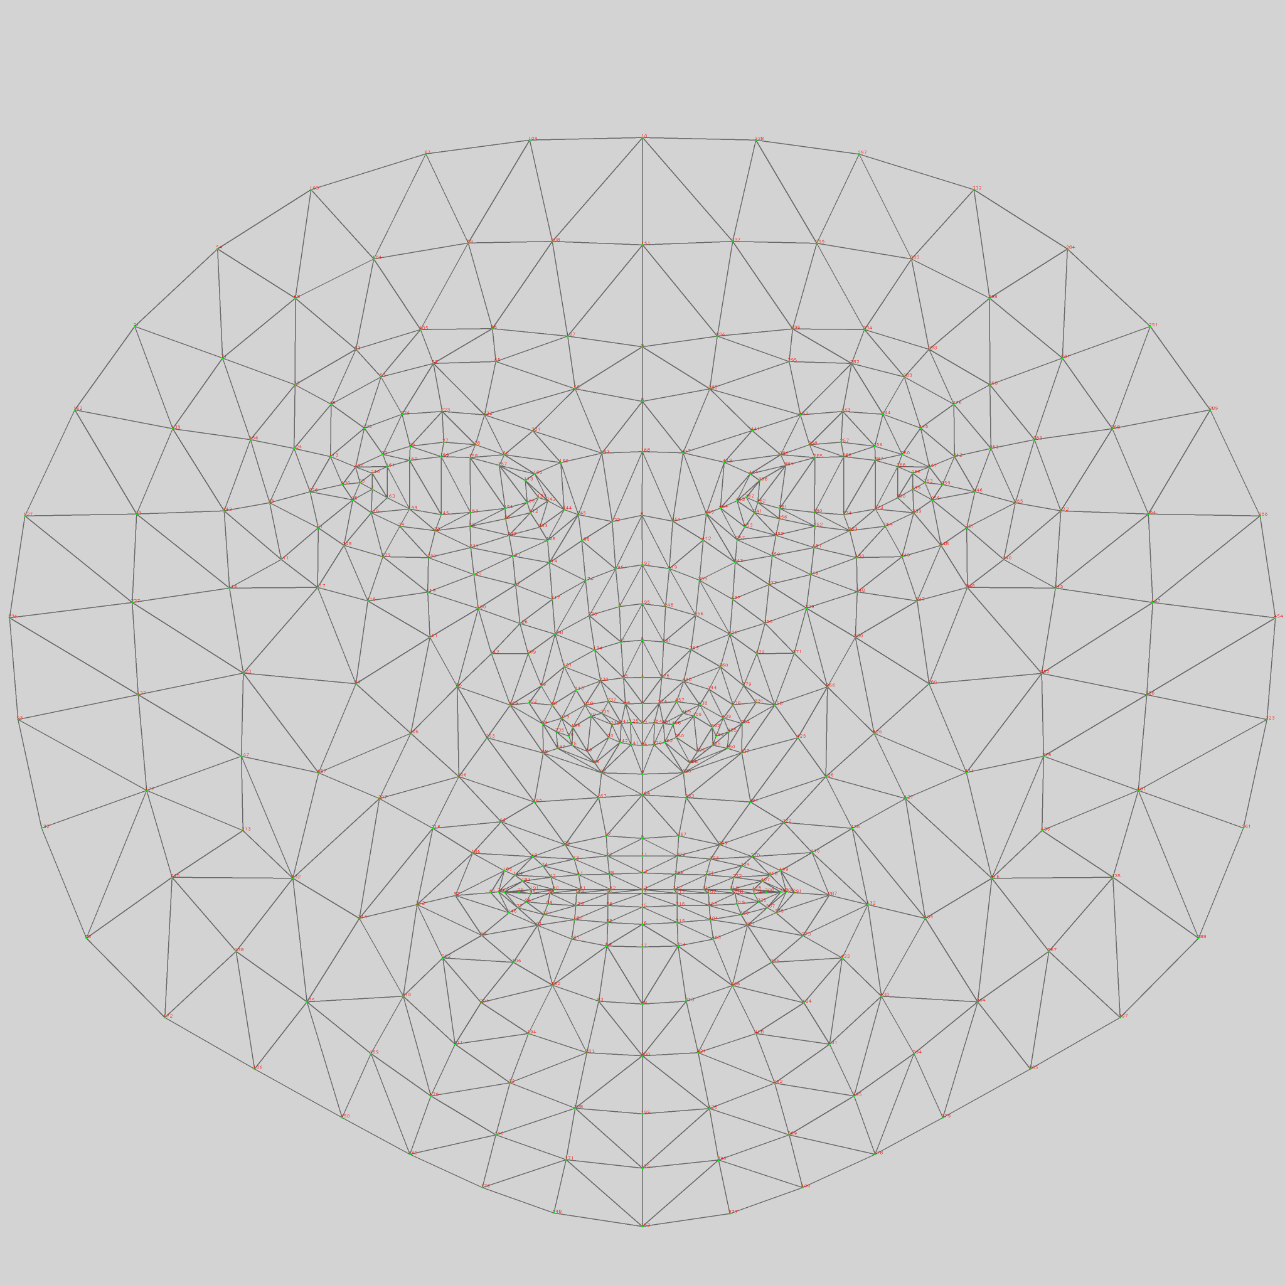
Algorithm
Because we are detecting facial expression, we must split and group the components of the face into two groups, making this different from the typical Face Keypoint Localization.
1. barely moving: Eyes and Forehead
2. a lot of motion: Lip, Chin and Cheeks
Notes:
So the 1st group is… it’ll be….
and the 2nd group is…
This is four hundred and seventy eight face key point from the FaceMesh.

Slide 11
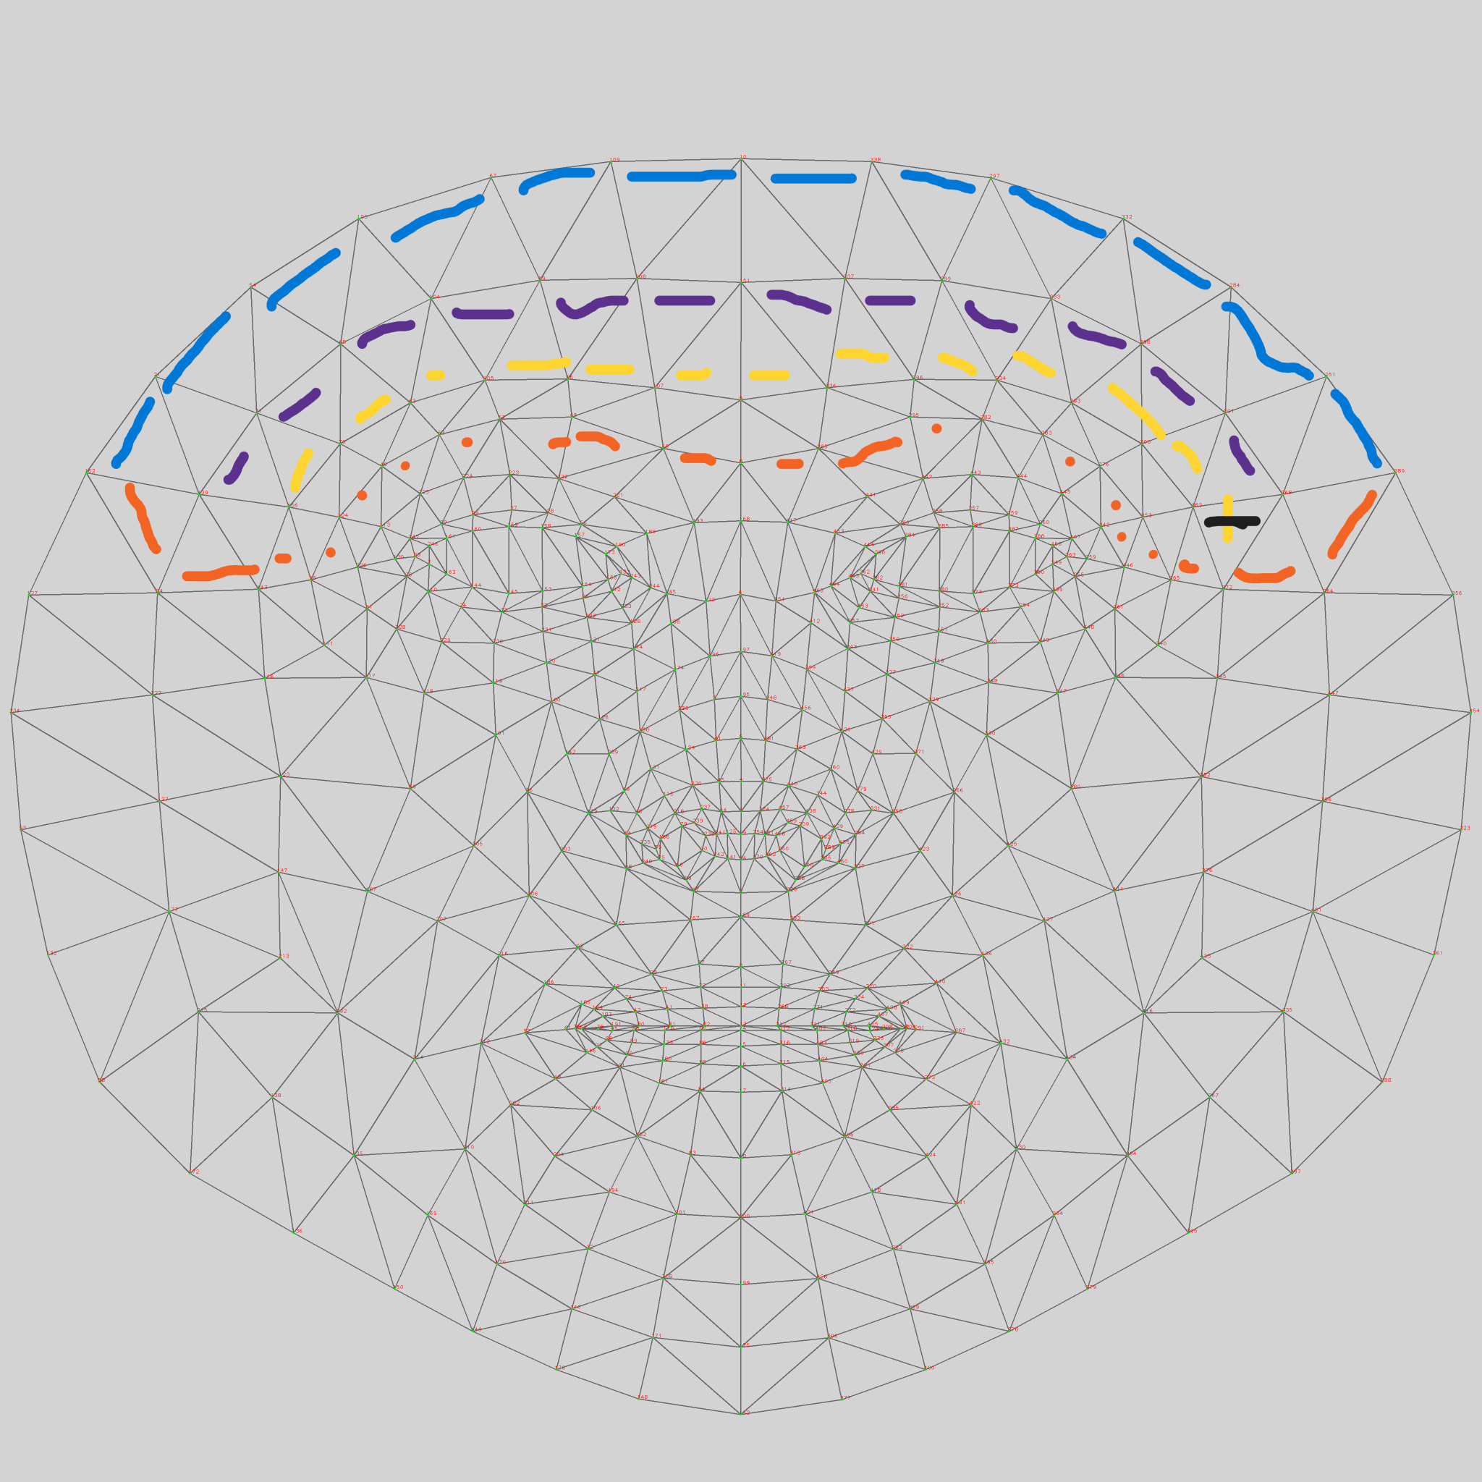
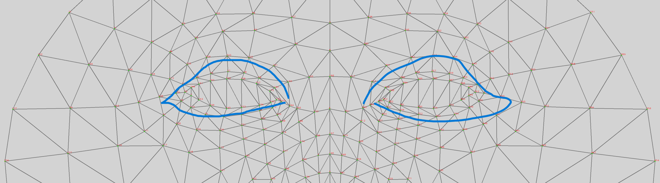
Algorithm
1. barely moving: Eyes and Forehead
Notes:
This is the area that we select for the facial key point of Barely moving group, eyes and forehead

Slide 12
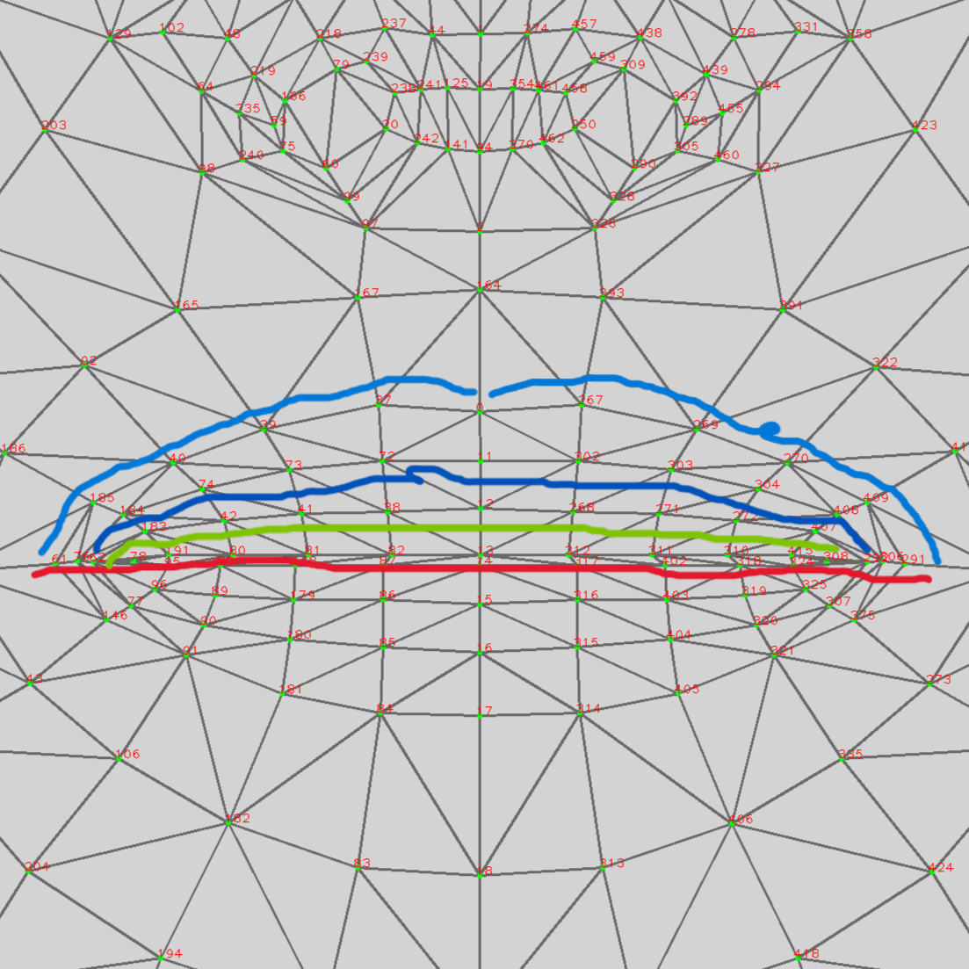
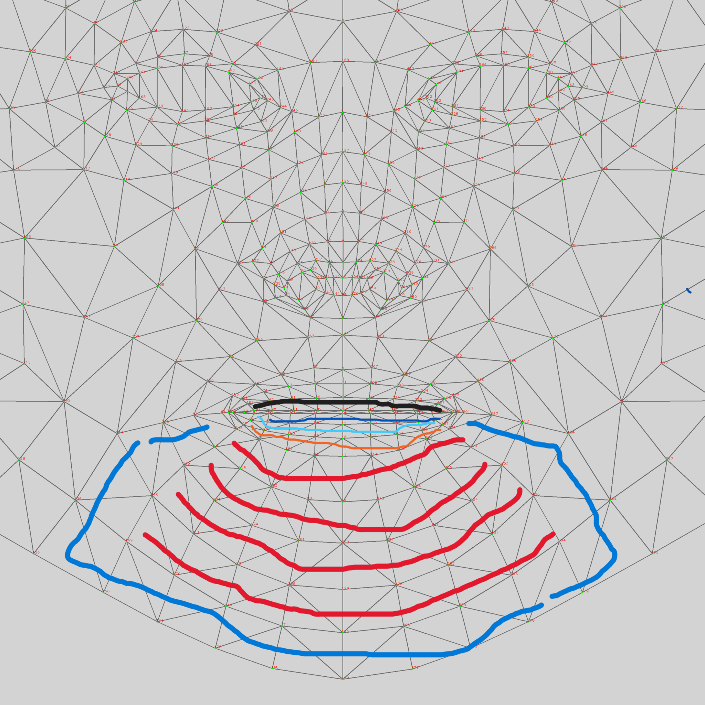
Algorithm
2. a lot of motion: Upper Lip, Lower Lip include Chin
Notes:
and this is for alot of motion group, upper lip and lower lip including chin

Slide 13
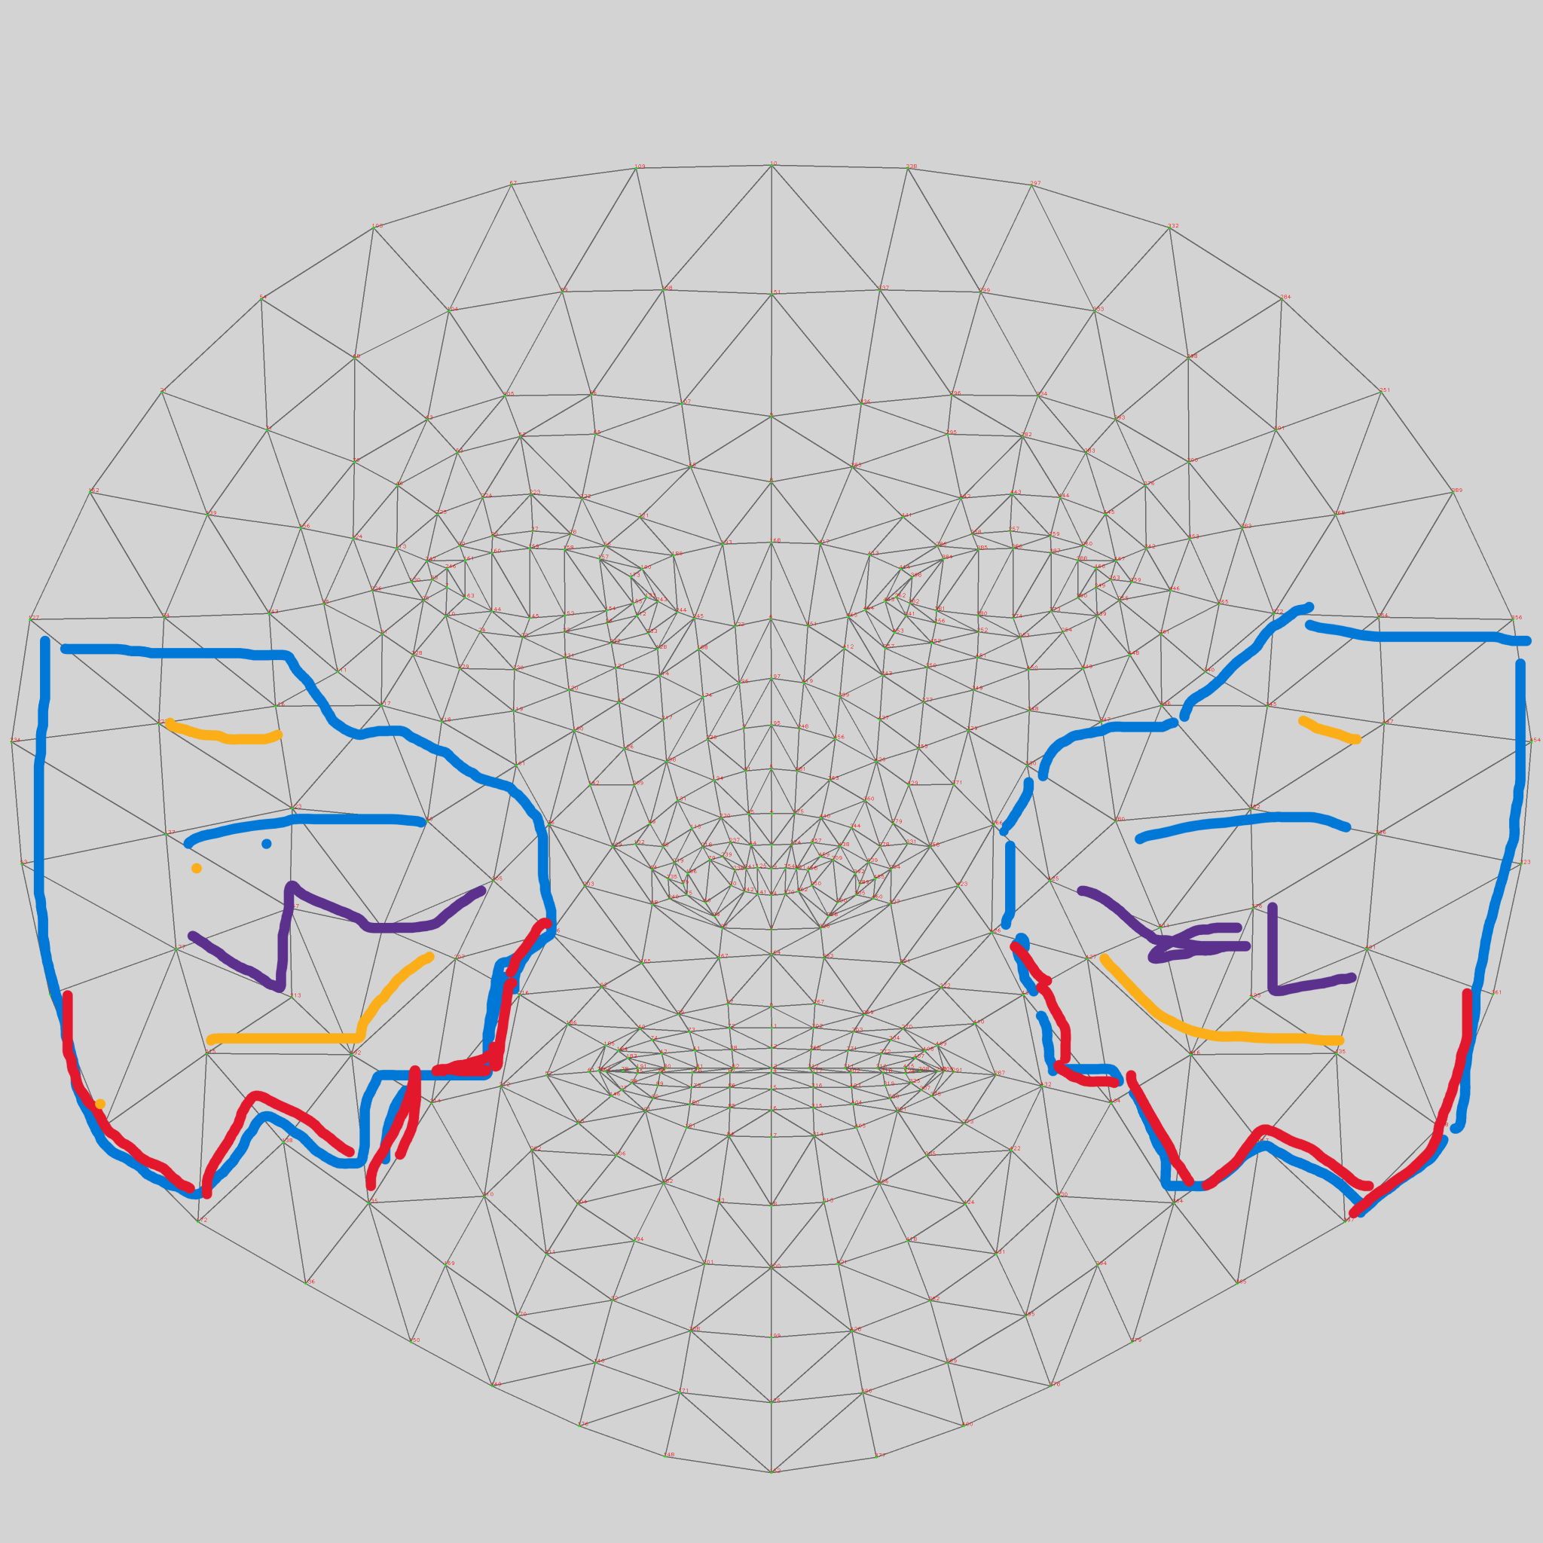
Algorithm
2. a lot of motion: Cheeks
Notes:
and this is 2side of cheeks

Slide 14
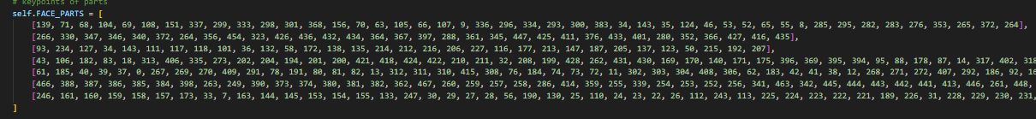
Algorithm
Assign Keypoint to the Component
1st Array:forehead 2nd Array:L-cheek
3rd Array:R-cheek 4th Array:chin
5th Array:Upper lip 6th Array: L-eye 7th Array :R-eye
Notes:
and then we collect it as 2D matrix in nested list form, the 1st one is….

Slide 15
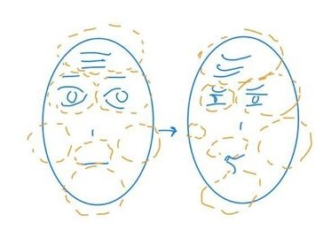
Algorithm
How to Calibrate the Expression!
1. Capture straight face then silly face
2. Compare them by Normalization
3. Calculate the difference between them as Expression of that person
Notes:
This is how we calibrate the expression

Slide 16
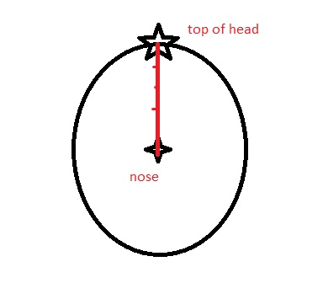
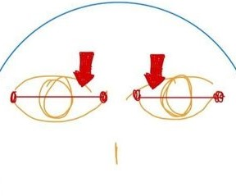
Algorithm
Normalization Ref Key Point!
forehead, cheeks, chin, mouth: Nose central point and Top of the head silhouette
Eyes: Eyelashes outside and inside
Notes:
By normalization we gonna calculate distance between Nose central point and Top of the head silhouette for using as reference for forehead, cheeks, chin and mouth
Then we use calculate distance between Eyelashes outside and inside of each eye to use as reference point for each eye

Slide 17
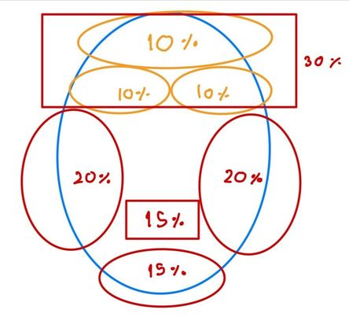
Algorithm
How to weight the score!
Red part: More Important
1. 2x 20% cheeks
2. 2x 15% Lip and Chin
Orange part: Less Important
1.10% Forehead
2. 2x 10% Eyes Forehead
Notes:
2 side of chin will be 20% each..***
Because the eye keypoint is likewise located in the forehead, the eye must be of equal weight to the forehead.
Because of the similarity in movement and area, the chin is included in the lower lip section.
After attempting to accurately visualize the worth of each part movement, we weigh them.

Slide 18

Algorithm
Flow of this game progression

Slide 19
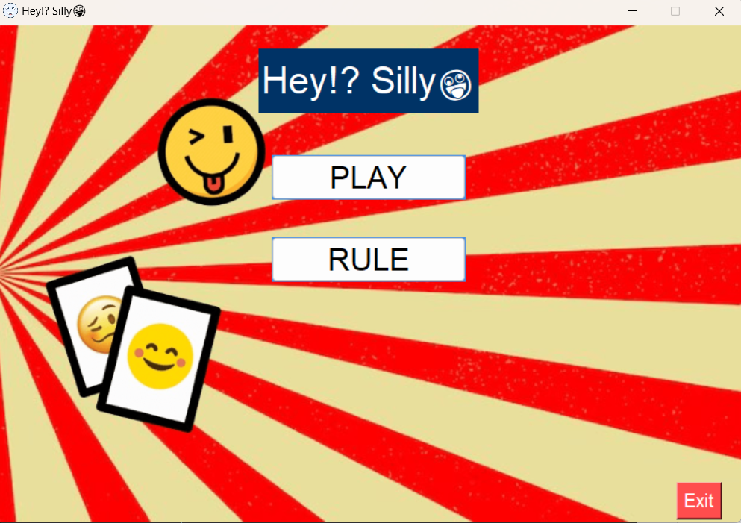
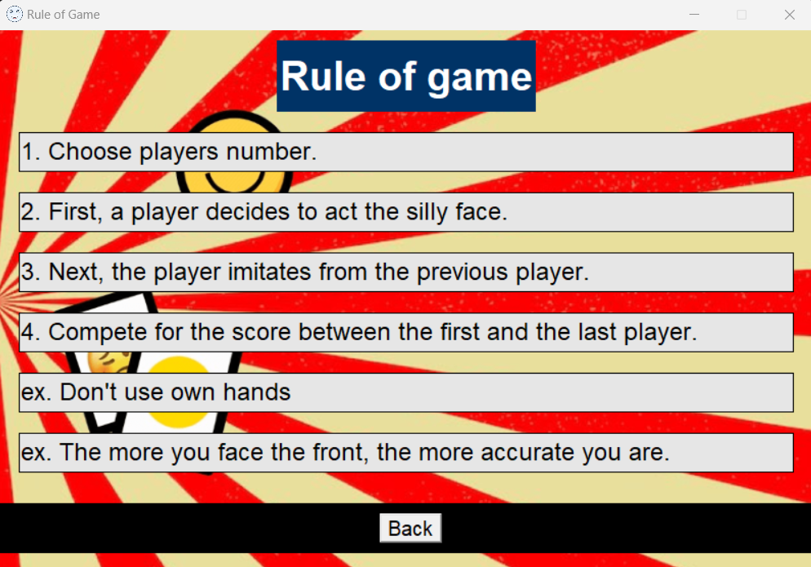
Algorithm
1. The welcome screen gave the player the option of playing or viewing the rules.

Slide 20
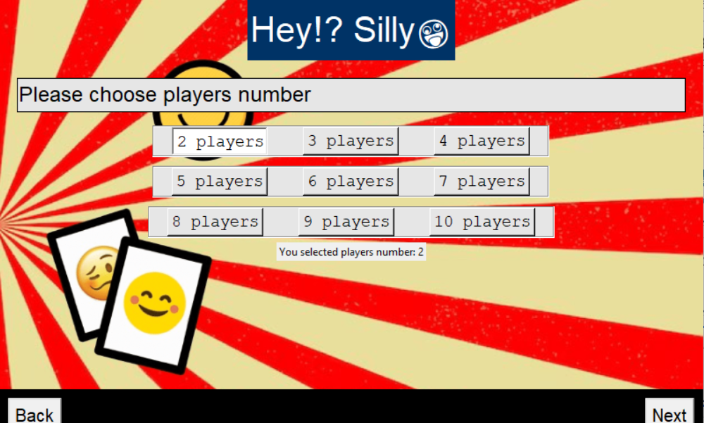
Algorithm
2. Selecting the number of attendees. [2 to 10 players]

Slide 21
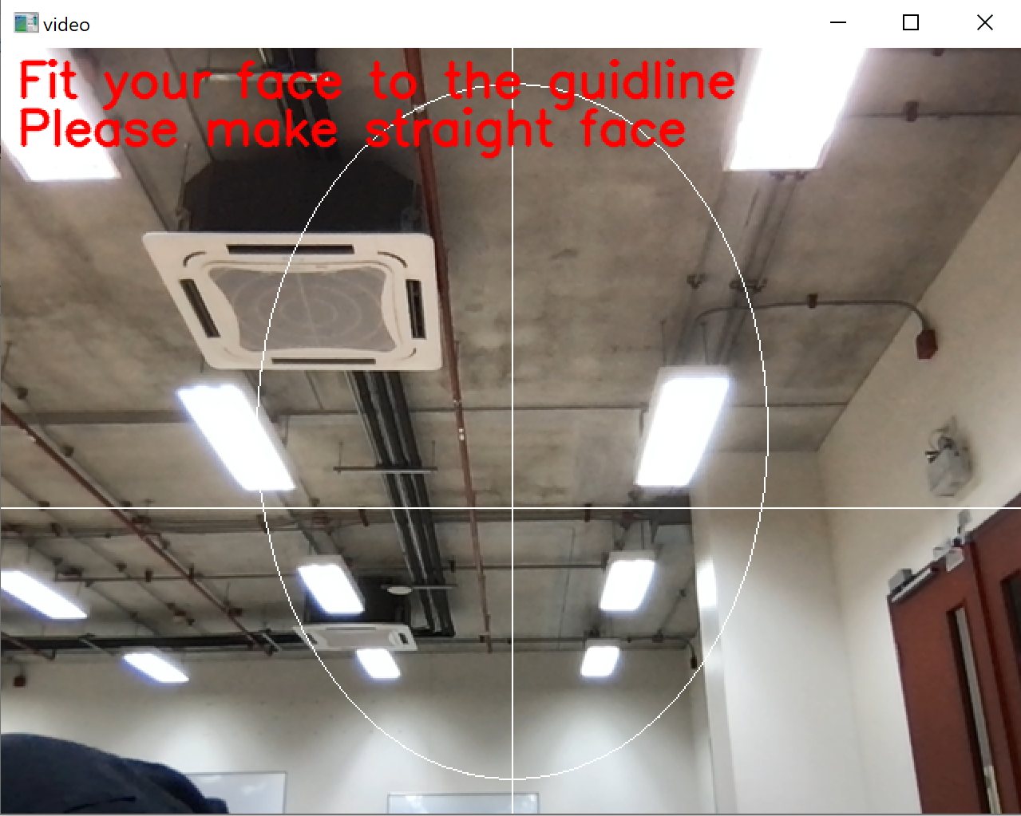
Algorithm
3. We draw a face outline on the screen and ask them to put their faces in it before activating the camera and shooting a shot.

Slide 22
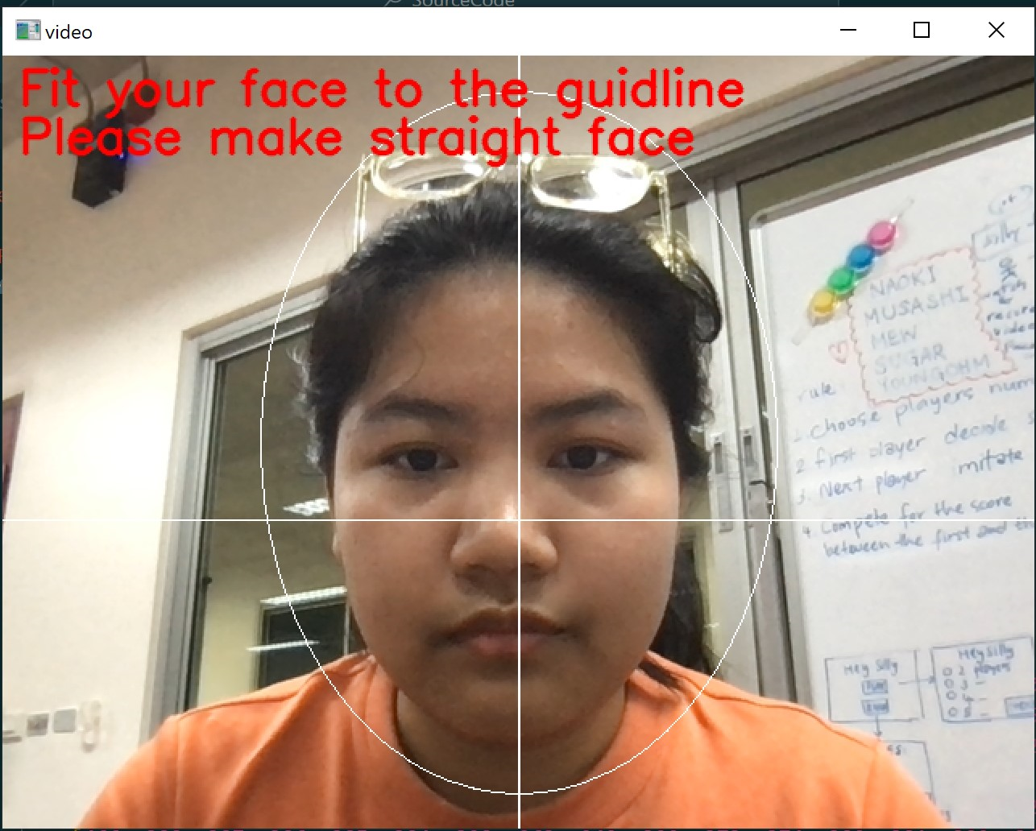
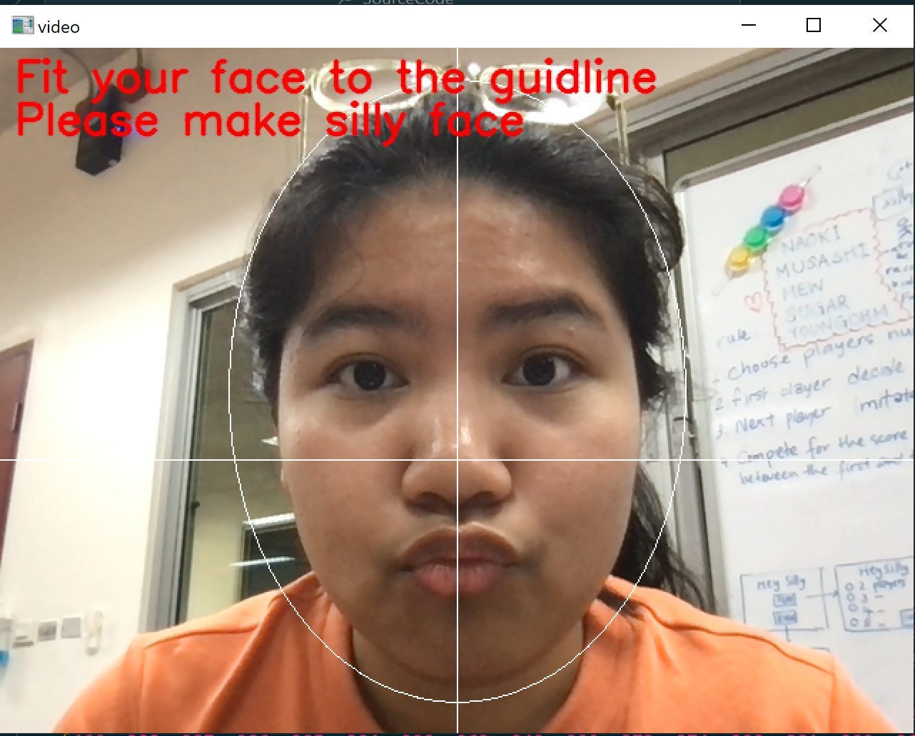
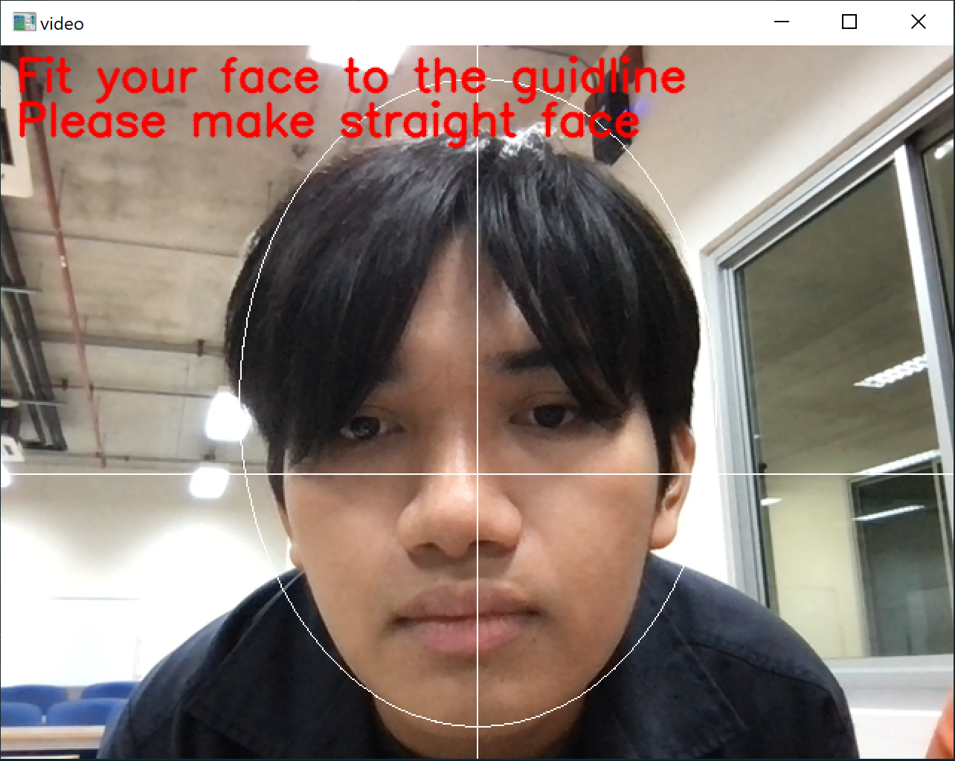
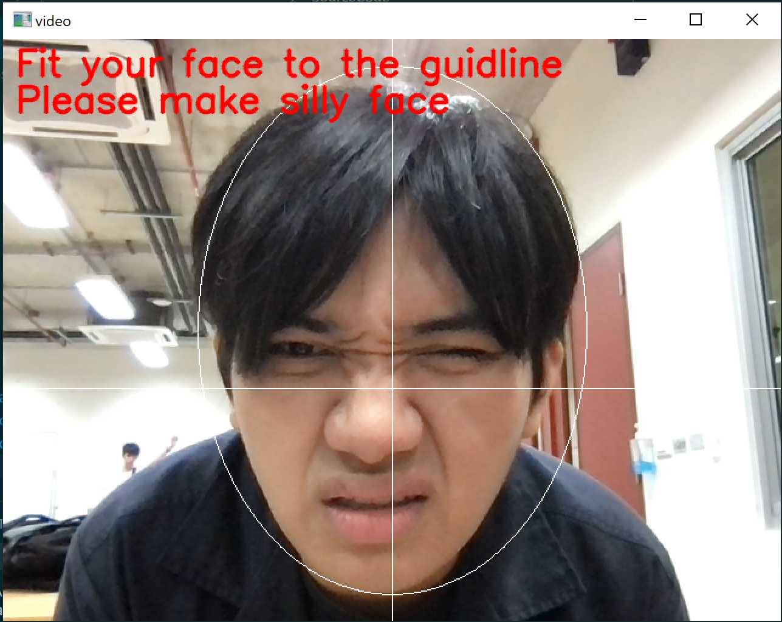
Algorithm
4. The first person's straight face is captured initially, followed by the first person's silly face, which is used for facial expression calibration according to how the silly face expresses. The second person is then shown the silly face, and they follow the same procedure as the first until there are no more attendees.

Slide 23
Algorithm
5. We will evaluate the differences between the keypoint algorithms for straight and silly face calibration to determine the score, comparing those attendees to the first attendees.

Slide 24
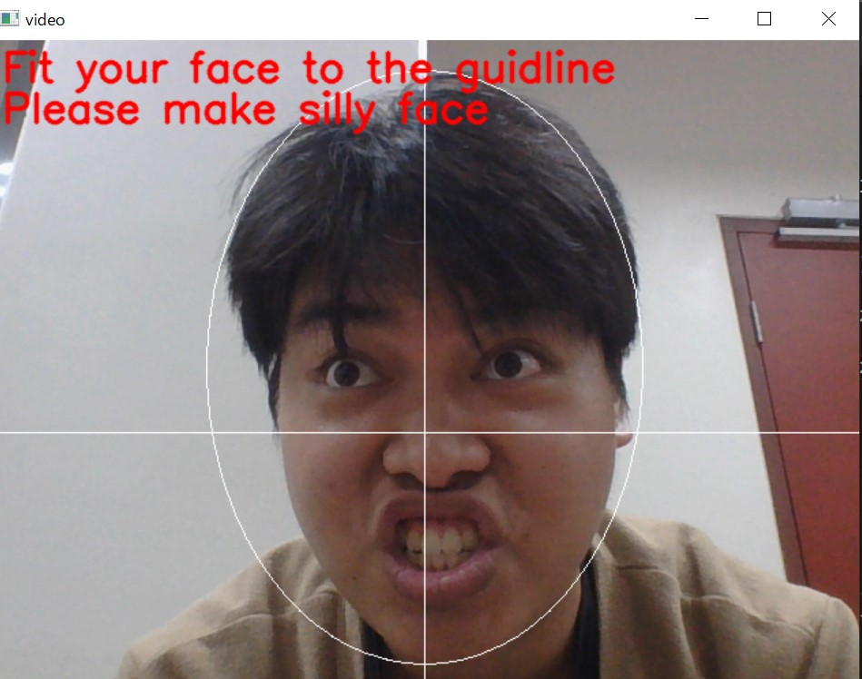
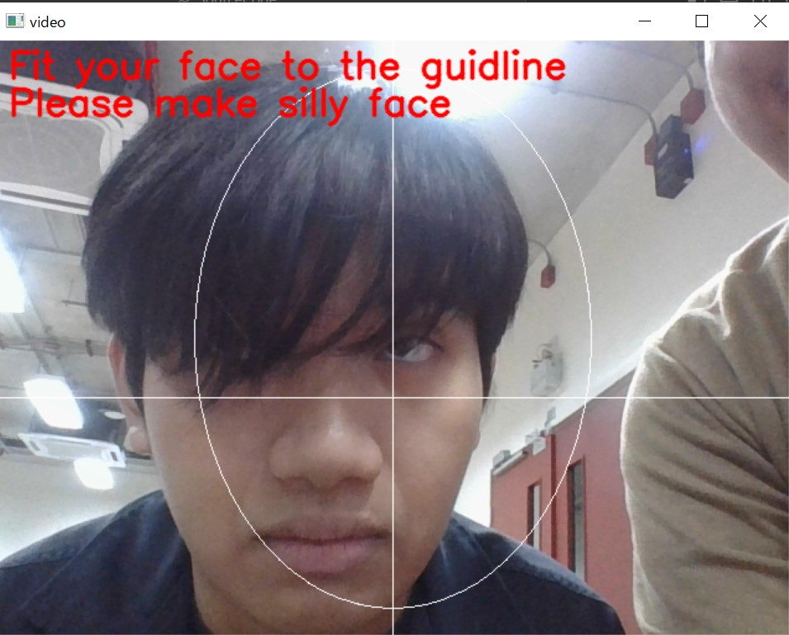
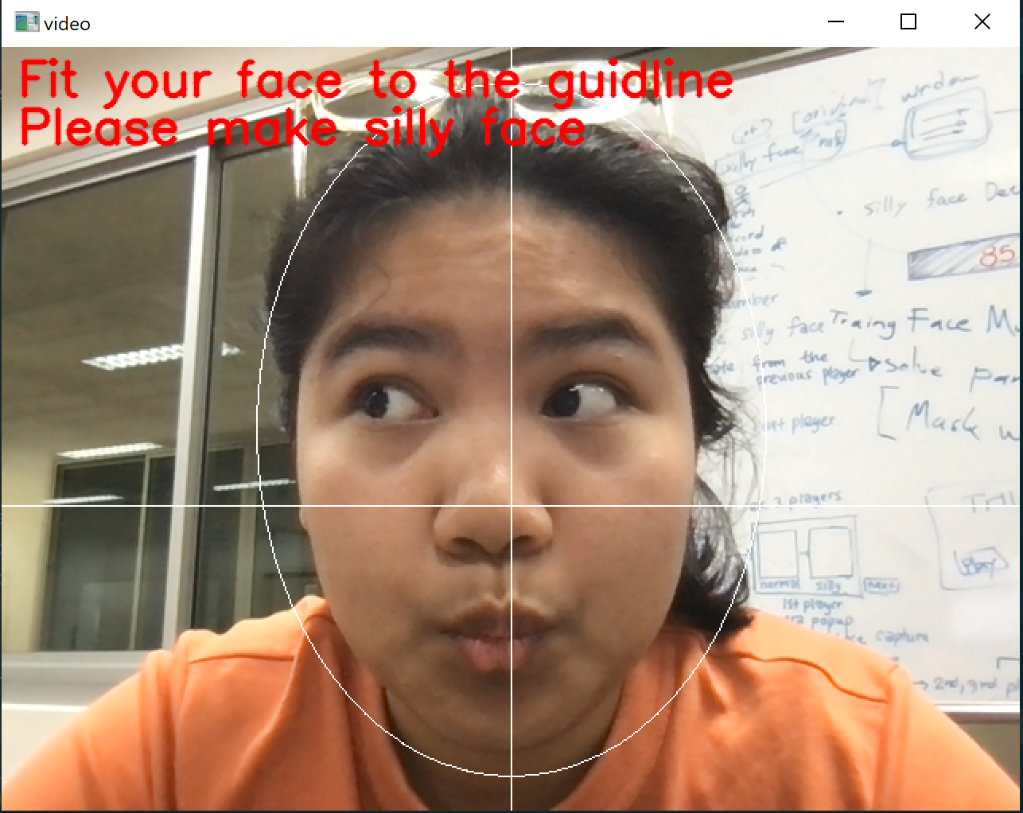
Algorithm
6. We're going to display the results using the final participant's score as the Team Score, but we'll also display each participant's score and his ridiculous expression just for fun!!!

Slide 25
Demonstrarion
Let’s play this game!!

